Slide 1

Draft LOITV Production Template
02.06.2021

Slide 2
General
Clubs must provide a minimum of the following for each fixture:
1 X HD Camera Output with Sport TV-trained Camera Operator
Audio set-up for Commentator & Co-commentator in addition to stadium ambient sound FX
Scoreboard/Clock
Graphics (see further details)
Pre-Match & HT Central League Ads/Content as directed
Instant highlights of key moments at half-time & full time
Replays of key incidents with flying logos
Stings to and from the action

Slide 3
Commentary
All Clubs are required to provide a match commentator and co-commentator for home fixtures.
Please ensure that these commentators are appropriate for this service and are well briefed before each fixture.
It is important that commentators are impartial without showing bias to either team etc. – avoid using phrases such as ‘we’, ‘us’ etc.
Please ensure that COVID-19 protocols are always adhered to in gantries etc.

Slide 4
Graphics
The centralised graphics templates must be used for the following areas (see notes re: positions in following slides):
LOITV logo (Top Right Hand Corner) – to be used at all times
Scoreboard Template (Top Left Hand Corner) – to include Club Crests, Match Time and Score – to be used during 90min
Lower Third Scoreboard Template (Bottom of Screen) - – to include Club Crests, Match Time and Score – can be displayed at any stage during the match/broadcast etc. Must include SSE Division Logo
Full-screen scoreboard graphic slate Template – to include Club Crests, Match Time and Score – can be displayed at any stage pre-match/half-time/full-time etc. Must include SSE Division Logo
Ticker Template (Bottom of Screen) - to insert Team Lists, Substitutions, Latest Scores etc.
Teamsheets Template - can be displayed at any stage pre-match/half-time etc. Must include SSE Division Logo
Font: The font type to use for the above graphics is ‘Assistant’

Slide 5
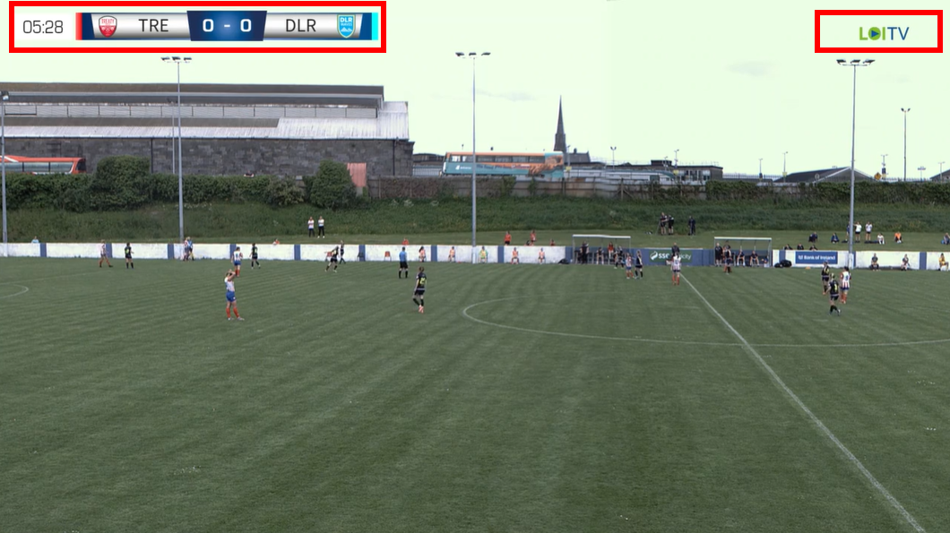
Graphics Examples
LOITV Logo & Scoreboard Position (same height of each):

Slide 6
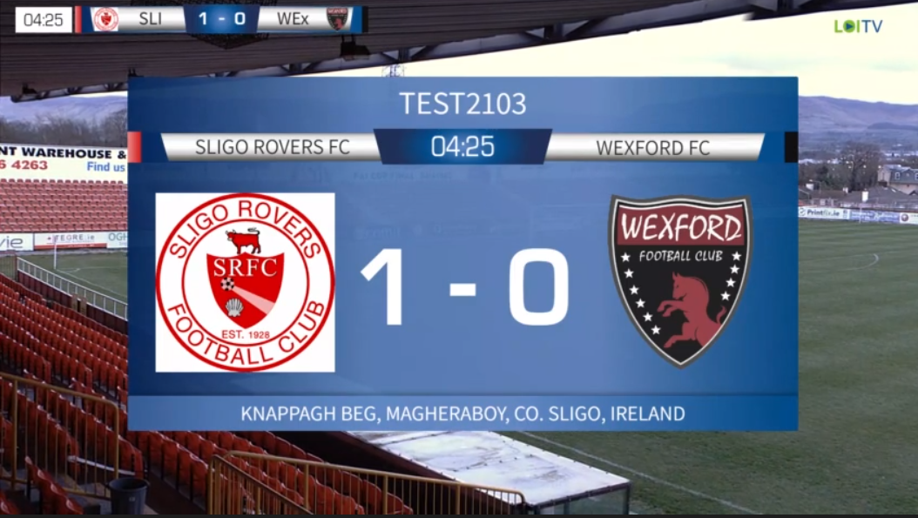
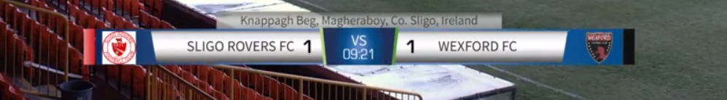
Graphics Examples
Scoreboard Slate:
Ticker:
Scoreboard Lower Third:

Slide 7
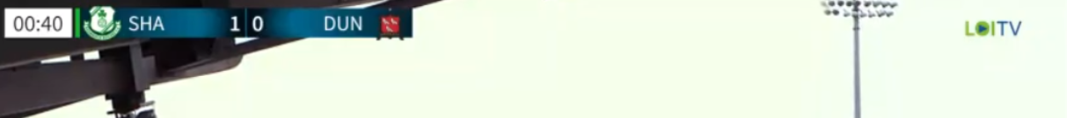
Scoreboard
Please ensure that the clock begins on time at the start of each half (0min for 1st Half, 45min for 2nd half).
Use 3 character club abbreviations – SHA, DUN etc.
Maintain consistent format as per below example.
Match Highlights
All clubs are requested to create a match highlights package which can also be posted on social media channels from 12noon on the following day after your fixture and can also be uploaded to the Sportradar platform.

Slide 8
Sponsorship
No Club Sponsors Advertisements during live in-match coverage (this can occur during pe-match/half-time/post-match however).
Only the Scoreboard/Clock (top left) and LOITV Logo (top Right) can appear on screen during Live Play. A Lower Thirds Score Flash can appear in breaks of play.
Instant Replay Stings must include appropriate SSE Airtricity Division Logo (i.e. Premier/First/WNL)
Pre-Match & HT Video Rolls to be provided to Clubs as necessary.
Graphics: Team Sheets, Full Score, Score Flash must include appropriate SSE Airtricity Division Logo (i.e. Premier/First/WNL).

Slide 9
Technical Specs
Please liaise with Sportradar about exact Technical Specs for transfer of feed via RTMP during the testing process.
Housekeeping
The League Office will control the administration for all fixtures on Sportradar and will liaise with clubs about supplying the correct RTMP feed for each fixture.

Slide 10
Ensure that the broadcast is live 30min pre-kick-off
Load Scoreboard for kick-off
Load Teamsheets Graphic pre-match
Load Teams via Ticker at beginning of match
Start commentary no later than 5min before kick-off
Kick-off – Begin Clock and manage Scoreboard
Half-time – Load Score Graphic with SSE Airtricity Logo
Full-time – Load Score Graphic with SSE Airtricity Logo
Matchday Checklist

